Slide 1
LOAN REPAYMENT PREDICTION
CSS
Team Members:
Kaarthikeyan AV – 71762133021
Vishwa R – 71762133050

Slide 2
SUMMARY
Loan repayment prediction using machine learning (ML) models is a crucial application in the financial sector that aims to assess the likelihood of a borrower repaying a loan based on various features and historical data.
This process helps financial institutions make informed decisions about approving or denying loan applications, setting interest rates, and managing risk.

Slide 3
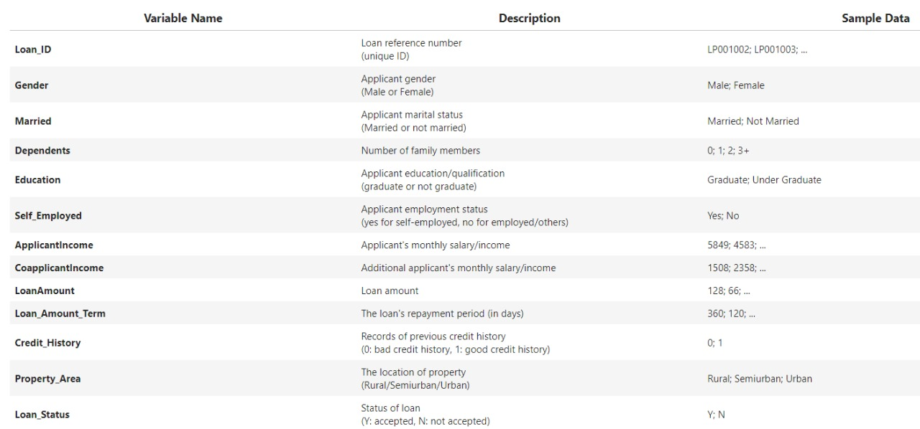
DATASET

Slide 4
SCOPE OF PROJECT
The scope of a loan repayment prediction project using machine learning is expansive and impactful, encompassing various stages of data collection, processing, modeling, and deployment within the financial sector.
This project aims to leverage historical loan data and borrower information to develop predictive models capable of assessing the likelihood of timely loan repayments.
It includes the careful curation of diverse datasets, cleaning and preprocessing to ensure data quality, and thoughtful feature engineering to enhance model performance.
Overall, the scope of this project extends from data preparation to ethical deployment, aiming to enhance the efficiency and fairness of loan approval processes in the financial industry.

Slide 5
ML ALGORITHMS
Simple Linear Regression
Multiple Linear Regression
SVM
RANDOM FOREST
KNN
ANN

Slide 6
01
Simple Linear Regression

Slide 7
Simple Linear Regression can be useful in a loan repayment prediction project, particularly when examining the relationship between a single independent variable and the dependent variable, such as predicting loan repayment based on a single feature
Simple Linear Regression focuses on modeling the relationship between one independent variable (feature) and the dependent variable (loan repayment).
Simple Linear Regression helps identify trends and patterns in the data, allowing for an initial exploration of the correlation between a specific borrower attribute and the likelihood of loan repayment.

Slide 8
02
Multiple Linear Regression

Slide 9
Multiple Linear Regression is a valuable tool in a loan repayment prediction project, especially when dealing with multiple independent variables (features) that collectively influence the dependent variable.
Multiple Linear Regression extends Simple Linear Regression to model the relationship between the dependent variable and multiple independent variables
Multiple Linear Regression allows for the prediction of a continuous outcome, such as estimating the expected amount of loan repayment based on multiple borrower characteristics.
By including multiple independent variables in the model, Multiple Linear Regression allows for the adjustment of potential confounding variables.

Slide 10
03
Support Vector Machine (SVM)

Slide 11
Support Vector Machines (SVM) play a significant role in a loan repayment prediction project as they are a powerful supervised learning algorithm suitable for both classification and regression tasks.
SVM is often employed for binary classification tasks, making it suitable for predicting whether a borrower is likely to repay a loan (positive class) or default (negative class).
In the context of loan repayment prediction using SVM, the algorithm helps in determining the decision boundary that best separates the classes of borrowers who are likely to repay their loans from those who may default.

Slide 12
04
RANDOM FOREST

Slide 13
Random Forest is a versatile and powerful ensemble learning algorithm that can be highly beneficial in a loan repayment prediction project.
Random Forest is an ensemble of decision trees. It builds multiple decision trees during training and merges them together to get a more accurate and stable prediction.
Random Forest is inherently parallelizable, allowing for efficient training on large datasets.
Random Forest can effectively handle missing values in the dataset. This is useful when dealing with incomplete borrower information, as it reduces the need for extensive imputation or data preprocessing.
Random Forest provides a measure of feature importance, indicating the contribution of each feature in making predictions.

Slide 14
05
K-NEAREST NEIGHBORS (KNN)

Slide 15
KNN is an instance-based learning algorithm, meaning it makes predictions based on the similarity between instances in the dataset.
KNN does not make assumptions about the underlying distribution of the data.
KNN is effective in capturing non-linear relationships between features and the target variable.
KNN is adaptable to changes in the dataset, making it suitable for dynamic environments where borrower characteristics or financial trends may evolve over time.
KNN provides straightforward interpretability, as predictions are based on the nearest neighbors in the feature space.
KNN allows customization of distance metrics based on the nature of the features.

Slide 16
06
ARTIFICIAL NEURAL NETWORK (ANN)

Slide 17
Artificial Neural Networks (ANNs) can be highly beneficial in a loan repayment prediction project, offering a powerful tool for modeling complex relationships within the data
ANNs excel at capturing non-linear relationships in data, making them suitable for modeling the intricate and often non-linear patterns present in borrower data and loan repayment behavior.
ANNs are capable of automatically learning relevant features from the input data.
ANNs are highly adaptable to varying levels of data complexity. They can handle both simple and complex relationships
Neural networks can leverage parallel processing capabilities, enabling faster training on large datasets.

Slide 18
CONCLUSION
In conclusion, the choice of machine learning models for a loan repayment prediction project depends on various factors, including the characteristics of the dataset, the nature of relationships between features, and the specific requirements of the financial institution.
Each of the four models—Simple Linear Regression, Mutiple Linear Regression, Logistic Regression, Random Forest, K-Nearest Neighbors (KNN), and Artificial Neural Networks (ANNs)—brings unique strengths to the table.
The loan repayment dataset has undergone EDA and data cleaning

Slide 19
Thank You

